Slide 1
DESIGNING the MODULES
Mehwish Mumtaz

Slide 2
Design Methodology
We have an abstract description of a solution to our customer’s problem, a software architectural design, a plan for decomposing the design into software units and allocating the system’s functional requirements to them
No distinct boundary between the end of the architecture-design phase and the start of the module-design phase
No comparable design recipes for progressing from a software unit’s specification to its modular design

Slide 3
Design Methodology
Design decisions are periodically revisited and revised
Refactoring
to simplify complicated solutions or to optimize the design

Slide 4
Design Principles
Design principles are guidelines for decomposing a system’s required functionality and behavior into modules
The principles identify the criteria
for decomposing a system
deciding what information to provide (and what to conceal) in the resulting modules
Dominant principles (general):
Modularity
Interfaces
Information hiding
Abstraction
Generality

Slide 5
Modularity
Modularity is the principle of keeping the unrelated aspects of a system separate from each other,
each aspect can be studied in isolation (also called separation of concerns)
If the principle is applied well, each resulting module will have a single purpose and will be relatively independent of the others
each module will be easy to understand and develop
easier to locate faults
because there are fewer suspect modules per fault
Easier to change the system
because a change to one module affects relatively few other modules
To determine how well a design separates concerns, we use two concepts that measure module independence: coupling and cohesion

Slide 6
Modularity: Coupling
Two modules are tightly coupled when they depend a great deal on each other
Loosely coupled modules have some dependence, but their interconnections are weak
Uncoupled modules have no interconnections at all; they are completely unrelated
Uncoupled -
no dependencies
Loosely coupled -
some dependencies
Tightly coupled -
many dependencies

Slide 7
Modularity: Coupling
There are many ways that modules can depend on each other:
The references made from one module to another
The amount of data passed from one module to another
The amount of control that one module has over the other

Slide 8
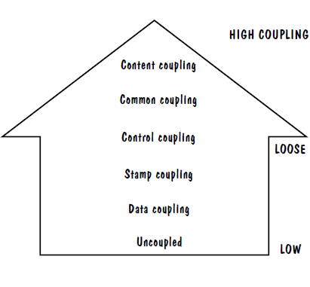
Modularity: Coupling: Types of Coupling
Content coupling
Common coupling
Control -coupling
Stamp coupling
Data coupling
High coupling is not desired

Slide 9
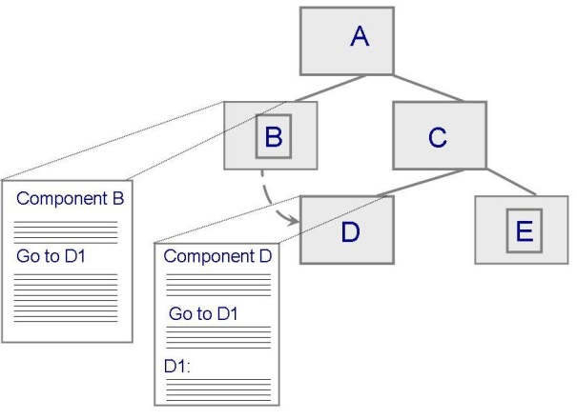
Modularity: Coupling: Content Coupling
One component modifies an internal data item of another component, a component (e.g. B) branches into another component (e.g. D)
Module B
_________________
_________________
_________________
_________________
Goto D1
_________________
_________________
_________________
_________________
_________________
_________________
_________________
_________________
Module D
_________________
_________________
_________________
_________________
_________________
_________________
D1:
_______________
_________________
_________________
_________________

Slide 10
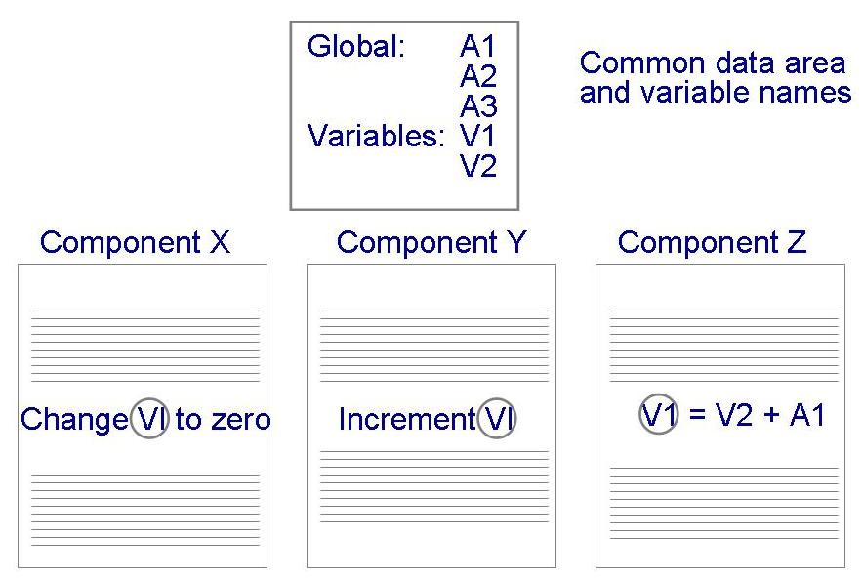
Modularity: Coupling: Common Coupling
Dependency due to common data. Which component is responsible to set a particular value for the common variable?
Tracing back to all components that access those data to evaluate the effect of the change

Slide 11
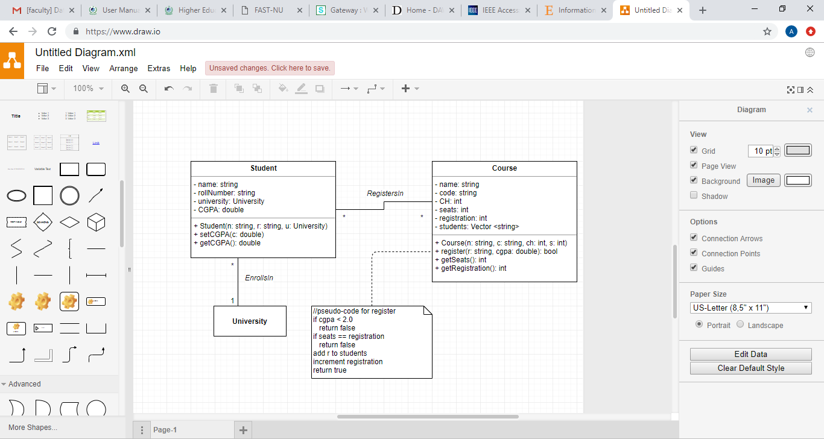
Modularity: Coupling: Control Coupling
One component passes parameters to control the activity of another component
The controlled component cannot function without direction from the controlling component
Make each component perform only one function

Slide 12
Modularity: Coupling: Stamp and Data Coupling
Stamp Coupling: Stamp coupling, or data structure coupling, occurs when modules share a composite data structure and use only a part of it, possibly different parts.
Stamp coupling occurs when complex data structures are passed between modules
Stamp coupling represents a more complex interface between modules, because the modules have to agree on the data’s format and organization
Data coupling
Data Coupling: Data coupling occurs when methods share data, regularly through parameters. Data coupling is better than stamp coupling, because the module takes exactly what it needs, without the need of it knowing the structure of a particular data structure.
Data coupling is simpler and less likely to be affected by changes in data representation
Only data value is passed from one component to another
Easiest to trace data and make changes

Slide 13
Modularity: Coupling: Types of Coupling
Content coupling
Common coupling
Control coupling
Stamp coupling
Data coupling
High coupling is NOT desired

Slide 14
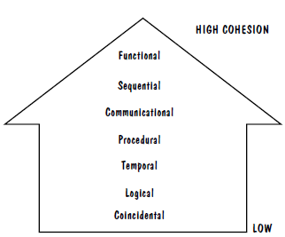
Modularity: Cohesion: Types of Cohesion
Cohesion refers to the dependence within and among a module’s internal elements (e.g., data, functions, internal modules)
Low cohesion is not desired

Slide 15
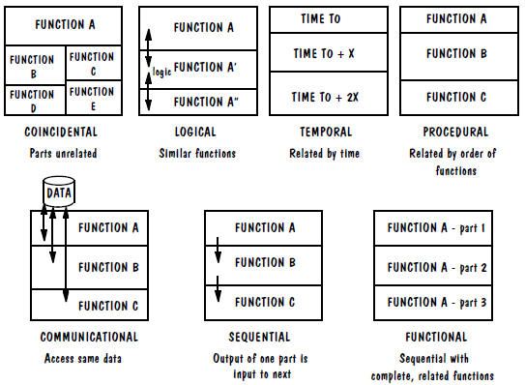
Modularity: Cohesion: Types of Cohesion

Slide 16
Types of cohesion
Coincidental Cohesion
E.g: Transaction Processing System: In a transaction processing system (TPS), the get-input, print-error, and summarize-members functions are grouped into one module
Logical Cohesion:
Logical cohesion is when parts of a module are grouped because they are logically categorized to do the same thing.
Print Functions: An example of logical cohesion is the case where a set of print functions generating different output reports are arranged into a single module.
Temporal Cohesion:
The set of functions responsible for initialization, start-up, shutdown of some process, etc. exhibit temporal cohesion.
Communicational Cohesion
Example: update record in the database and send it to the printer.
Sequential Cohesion:
e.g. a function which reads data from a file and processes the data).
Functional Cohesion.
Assign Seat to passenger

Slide 17
Modularity: Cohesion: Types of Cohesion
In Sequential cohesion, activities are related and output for current activities is input for next activity but in procedural cohesion activities are unrelated.
Example for Sequential Cohesion : Let us take an example of getting data from database. Below will be steps for this task. 1. Get result set from sql command 2. prepare result set 3. return result set In this example sequence is followed and each activity's result is input for next activity. If any of the activity is not executed successfully then next activity will not executed.
Example for Procedure Cohesion : Let us take example of above module. 1. create connection string 2. Open connection using SqlConnection class 3. Execute sql command suing SqlCommand 4. Get resultset using SqlDataReader

Slide 18
Interfaces
An interface defines what services the software unit provides to the rest of the system, and how other units can access those services

Slide 19
Interfaces (Contd.)
A software unit may have several interfaces that make different demands on its environment or that offer different levels of service
Module
Data
________________
_________________
_________________
Operation 1
_________________
_________________
_________________
_________________
Operation 2
_________________
_________________
_________________
_________________
Interface A
Operation 1 ()
Operation 2 ()
Operation 4 ()
Operation 3
_________________
_________________
_________________
_________________
Operation 4
_________________
_________________
_________________
_________________
Interface B
Operation 2 ()
Operation 3 ()

Slide 20
Information Hiding
Information hiding is distinguished by its guidance for decomposing a system:
Each software unit encapsulates a separate design decision that could be changed in the future
Then the interfaces and interface specifications are used to describe each software unit in terms of its externally visible properties

Slide 21
Abstraction
An abstraction is a model or representation that omits some details so that it can focus on other details
The definition is vague about which details are left out of a model, because different abstractions, built for different purposes, omit different kinds of details

Slide 22
Generality
Generality is the design principle that makes a software unit as universally applicable as possible, to increase the chance that it will be useful in some future system
We make a unit more general by increasing the number of contexts in which it can be used.

